Slide 2






Technologies Used for Analysis
Geopandas

Slide 3

Complete Source Code and Project files Available at
https://github.com/tomseeber/college_data_analysis

Slide 4
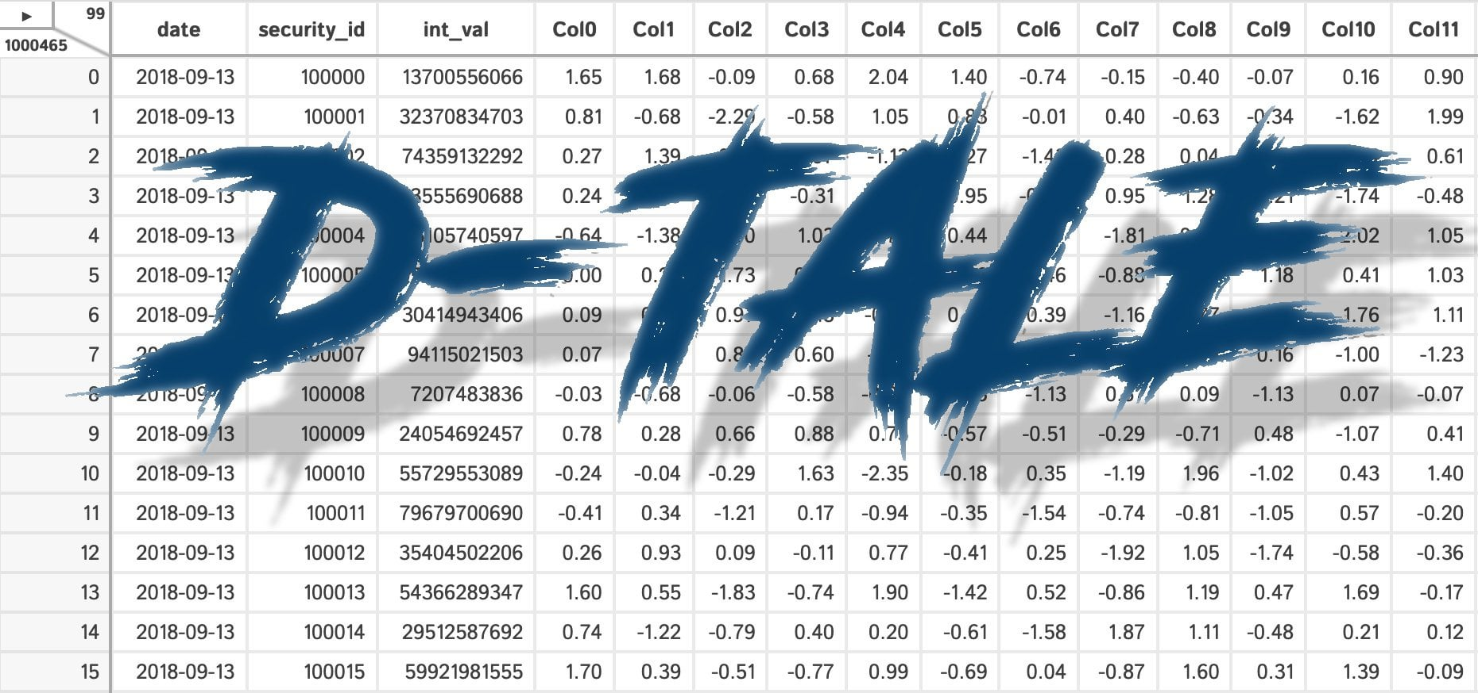

Exploratory Data Analysis (EDA): New Tools Implemented
Some basic EDA was created using Automated tools. Jupyter notebooks are provided.
Exploratory
PandasAI

Slide 5
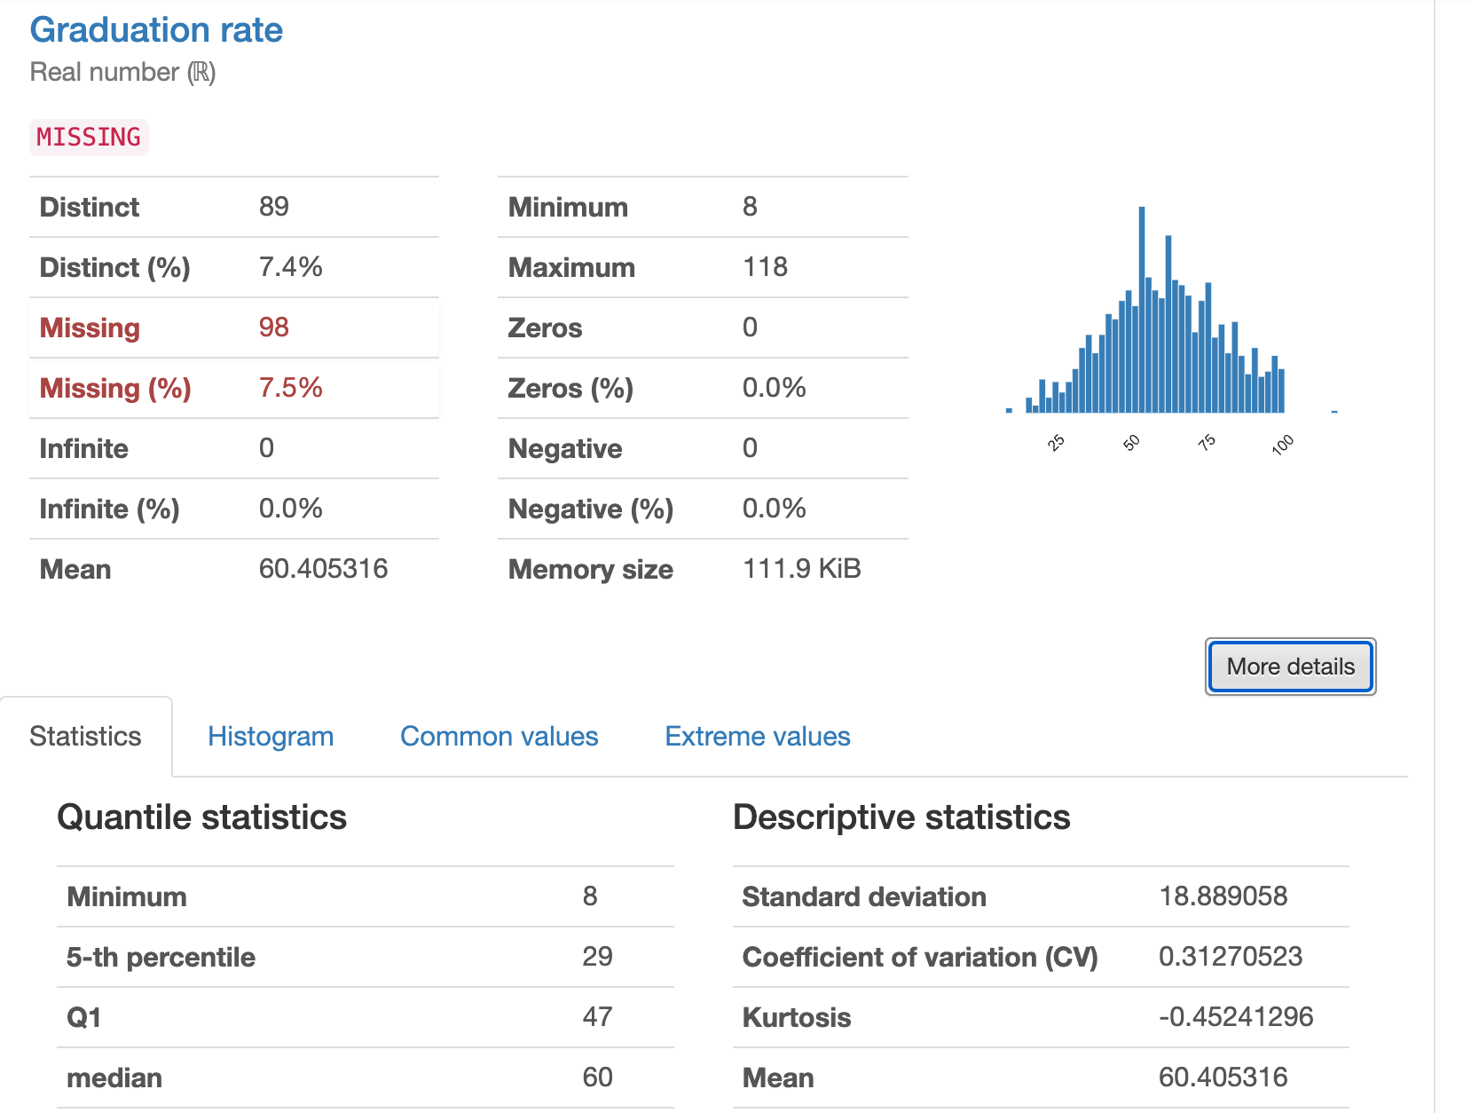
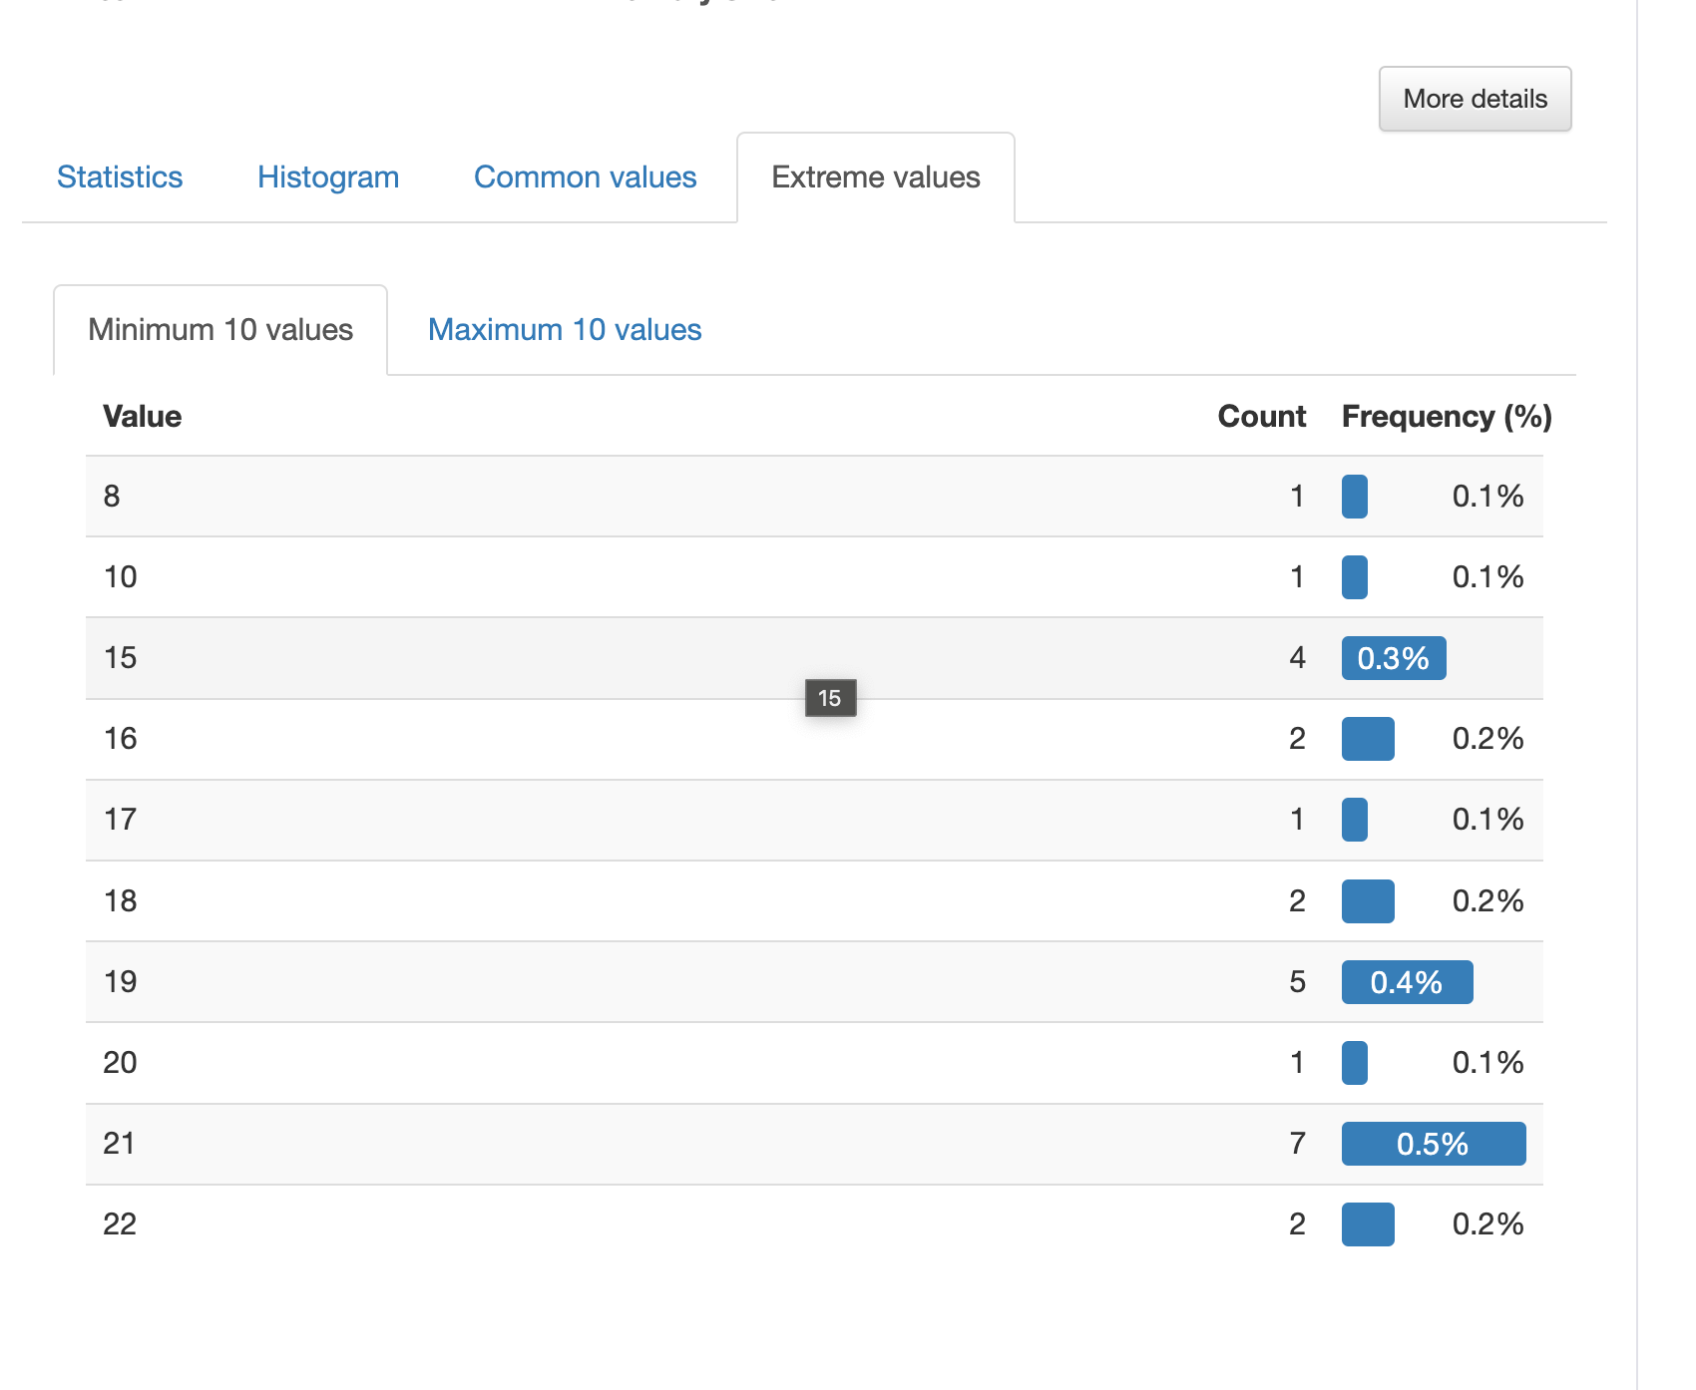
EDA: Panda Profiling ( New Tools)
Panda Profiling lets you derive all basic statistics, outliers, correlations, and basic EDA information in one interface.
https://pypi.org/project/pandas-profiling/

Slide 6
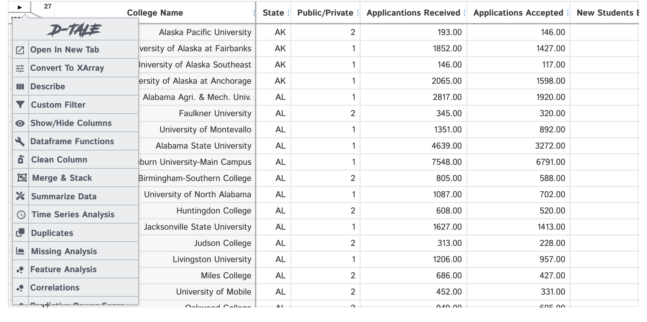
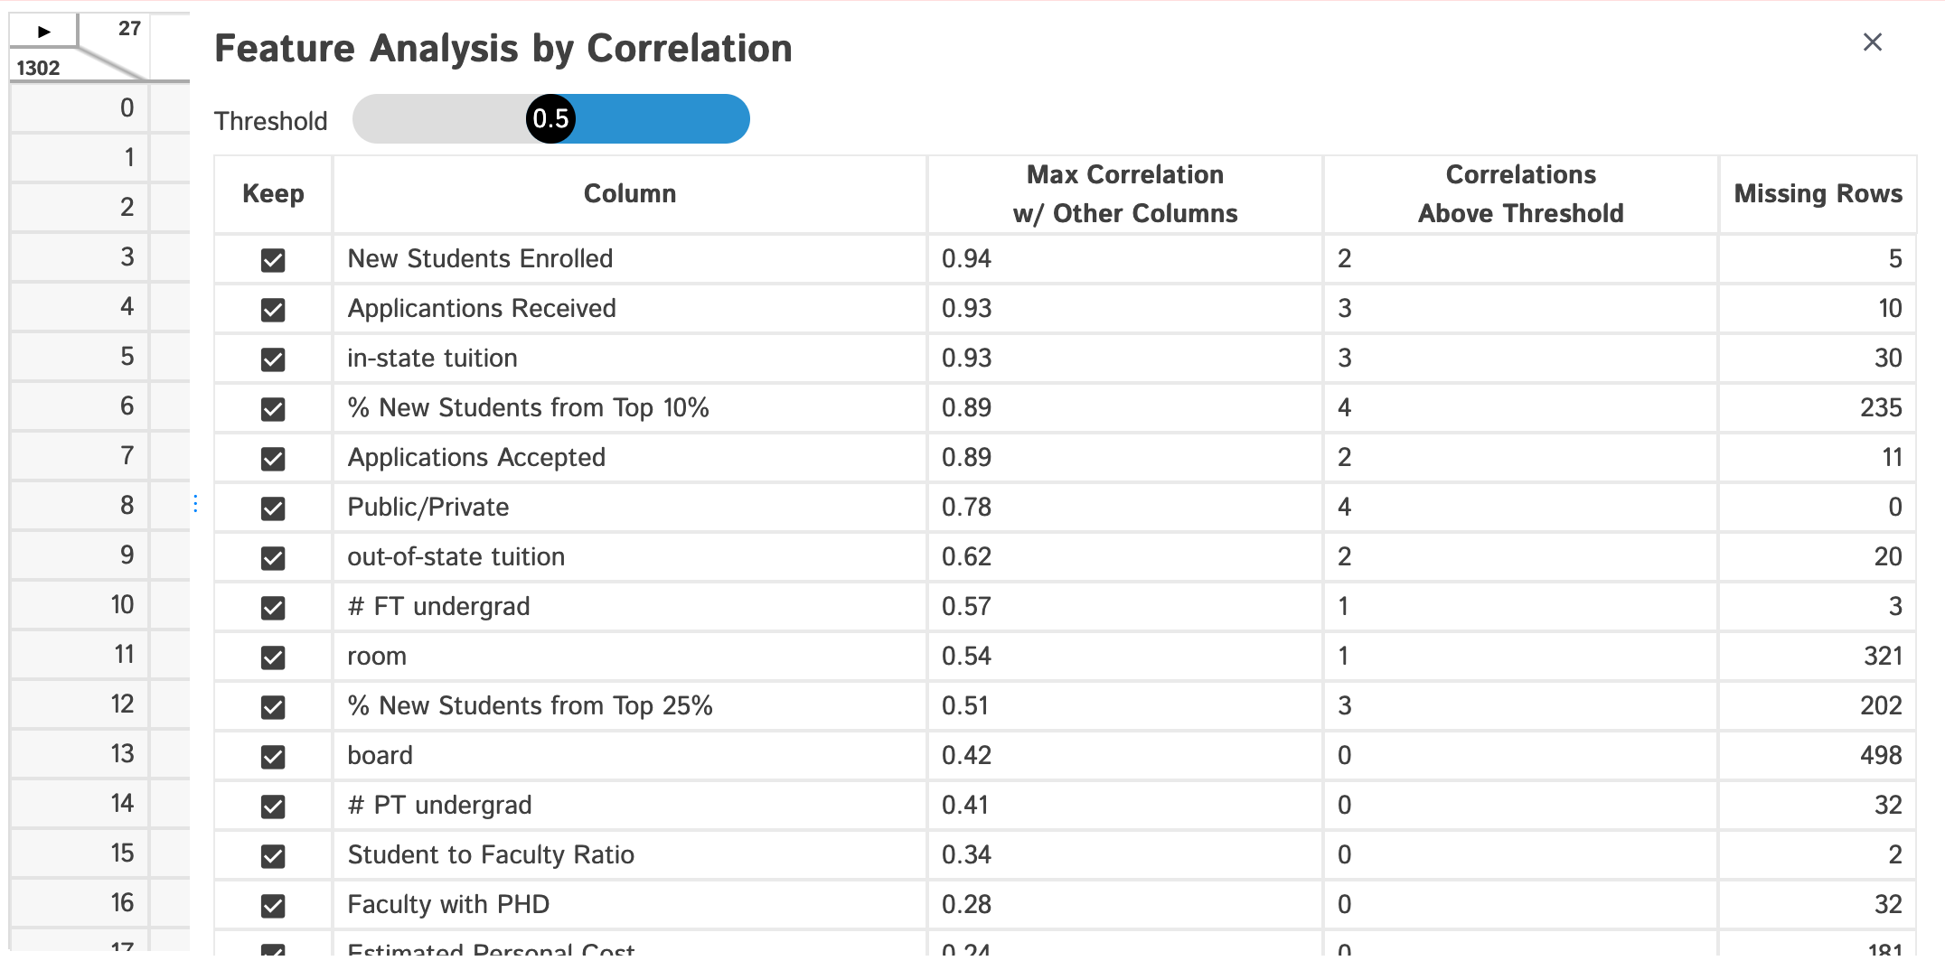
EDA: D-Tale ( New Tools)
D-Tale lets you derive all basic statistics, outliers, correlations, and basic EDA information in one interface as well, but also does feature analysis, and on the fly graphing with GUI
https://pypi.org/project/dtale/

Slide 7
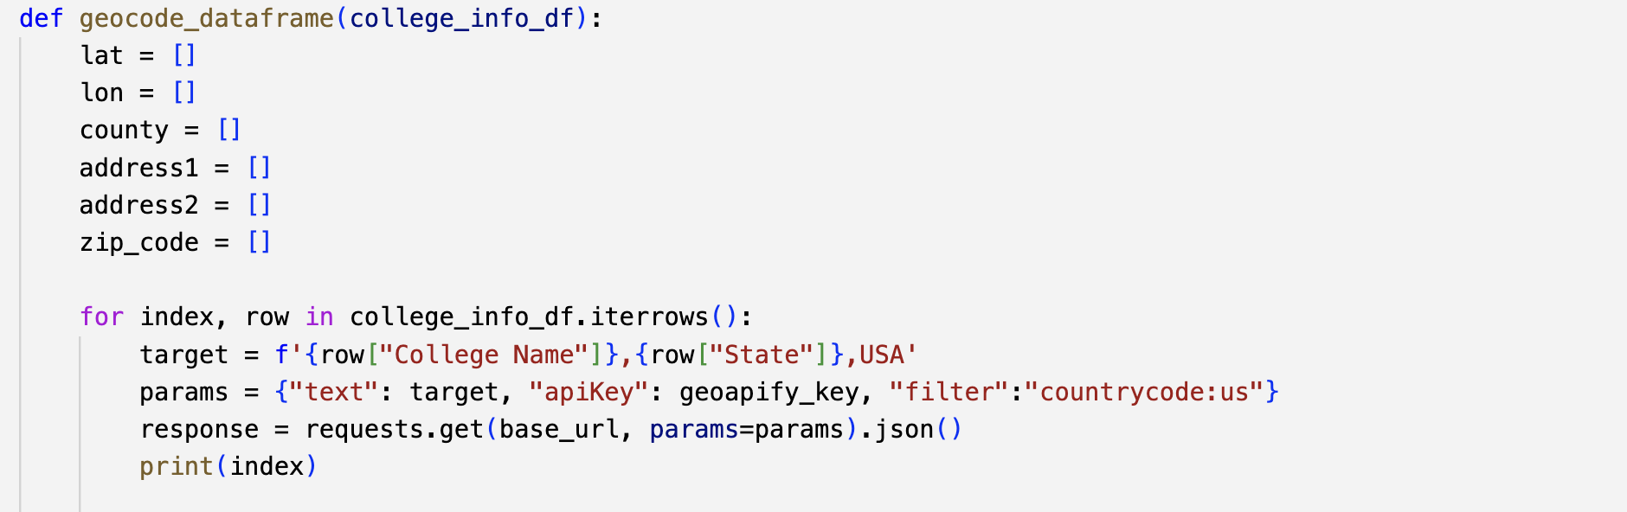
ETL Processes: Adding In Additional Data - Geocoding
Added Latitude and Longitude to Address Data ( Geocoding ) through the Geofy
Allows for direct mapping and geospatial analysis
Maps
Connection to US Census and demographic data

Slide 8
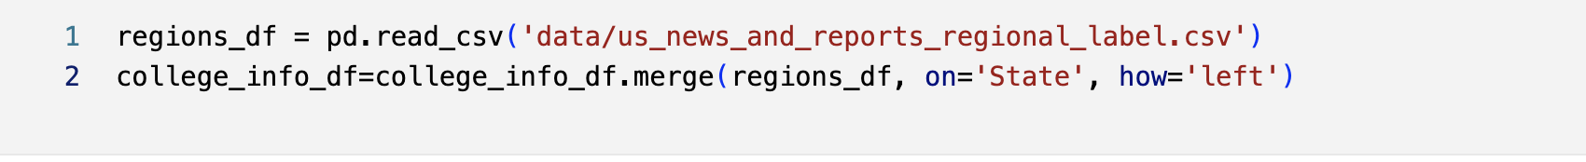
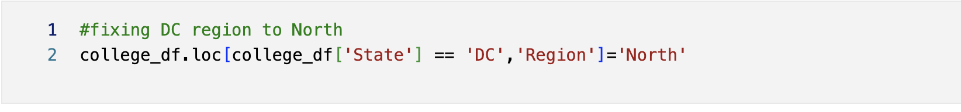
ETL Processes: Adding In Additional Data - US Reports Regions
Added Regional Data from the US and News and Reports
Original States per Region in US News and Reporting
Extracted from 2016 Information from ChatGPT
Cross-Region comparisons
Adding Regional Information for DC, since DC was not included in the State extraction

Slide 9
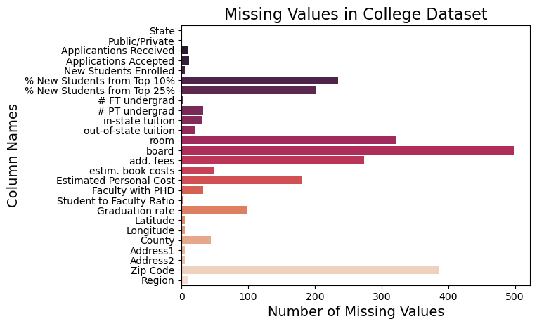
Data Cleaning: Missing Data: No drop_na
Using the Pandas Method Drop_na takes our record count from 1302 to 471 with a 63.82% reduction in data.
We can’t use such a blunt tool.
Case-by-case dropping using dropna with a subset on specific columns

Slide 10

Data Cleaning: Correcting Types
Converted string columns to numeric (Float or INT) in Pandas
Corrected any typos or mistakes that would prevent this conversion via Pandas and Loc.
Kept data in Excel using Pandas Excel functionality conversions to avoid unneeded string-to-number conversions.
No Data Time functionality was needed.

Slide 11
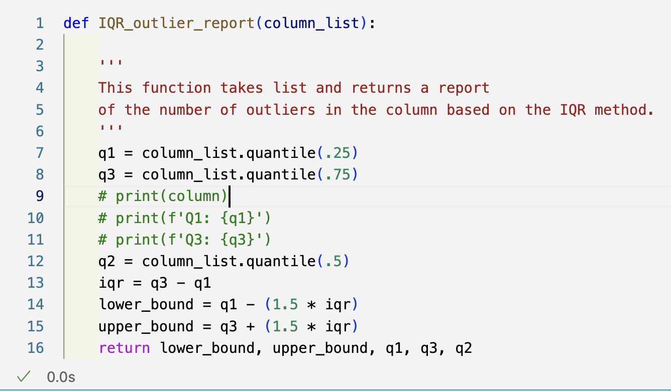
Outliers: Detection
The IQR method uses the quartiles +- 1.5 ( Code is on the right).
Easy to deal with outliers:
120 for the Graduation Rate is impossible; manually fixed this with correct data. ( Fixing these )
Case Western Reserve University does not have a 2.9 Student to Faculty Ratio, and most lower than Q1-IQR*1.5 are probably incorrect data
Harder to Dismiss
~48000 applications for Rutgers University in 2016 are correct.
Similarly, in and out-of-state tuitions, some schools are correctly expensive outliers. Can we drop MIT from a college report?

Slide 12
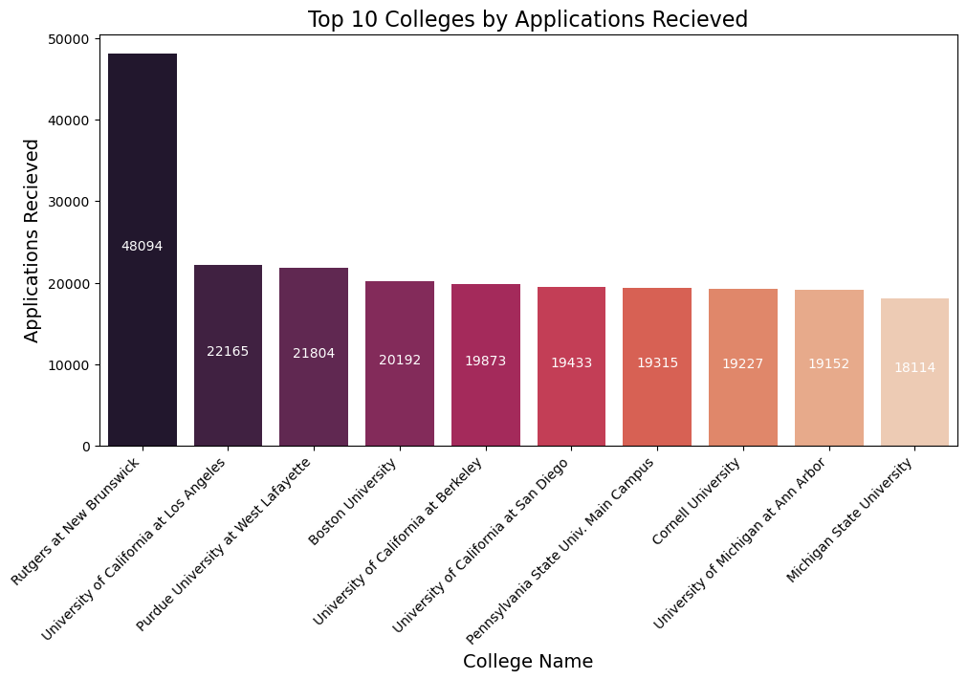
Data Cleaning: Most Outliers
Most columns in the data have higher variability.
Outliers tend to look like the top 10 colleges by Applications Received.
All items are outliers in this chart, and all are relevant.
Outliers in this data can not be summarily dismissed.
All of these are outliers and all 100% correct

Slide 13
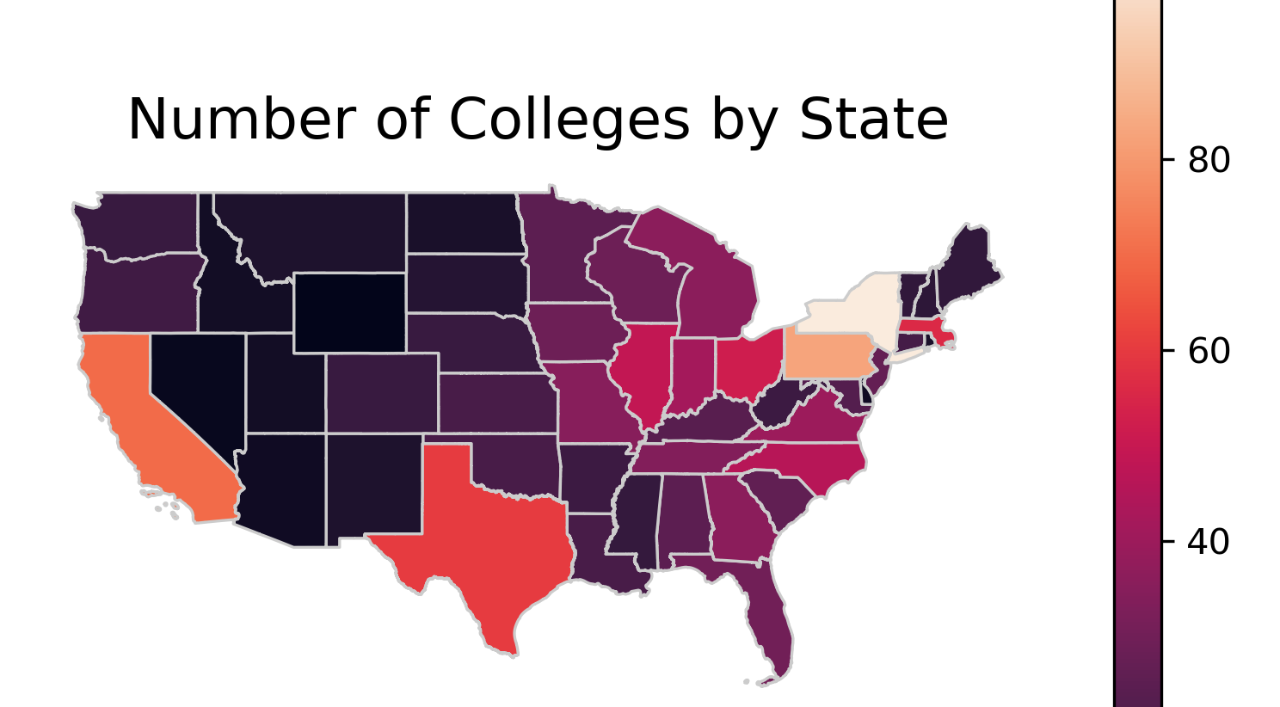

Slide 14
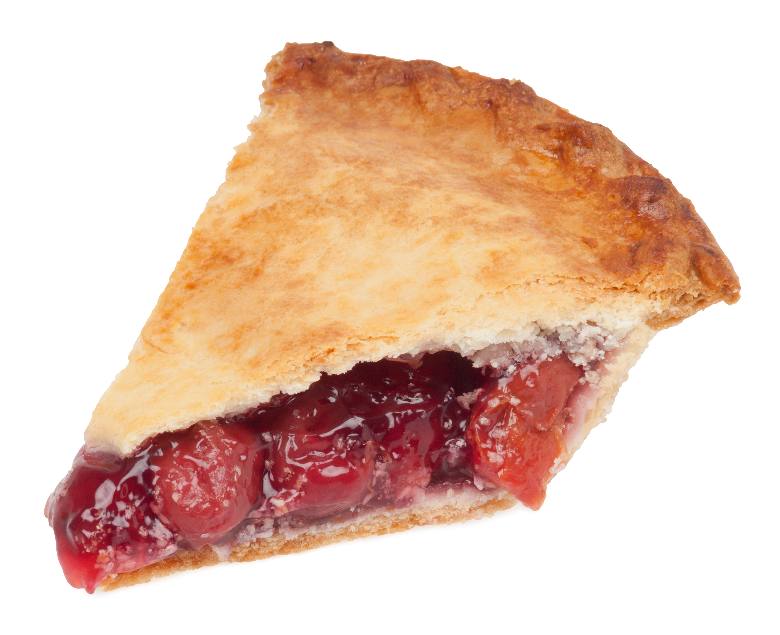
Data Cleaning: For Outliers Strategy of Segmentation
Schools with larger applications pools seem different and act
This Photo by Unknown Author is licensed under CC BY-SA

Slide 15
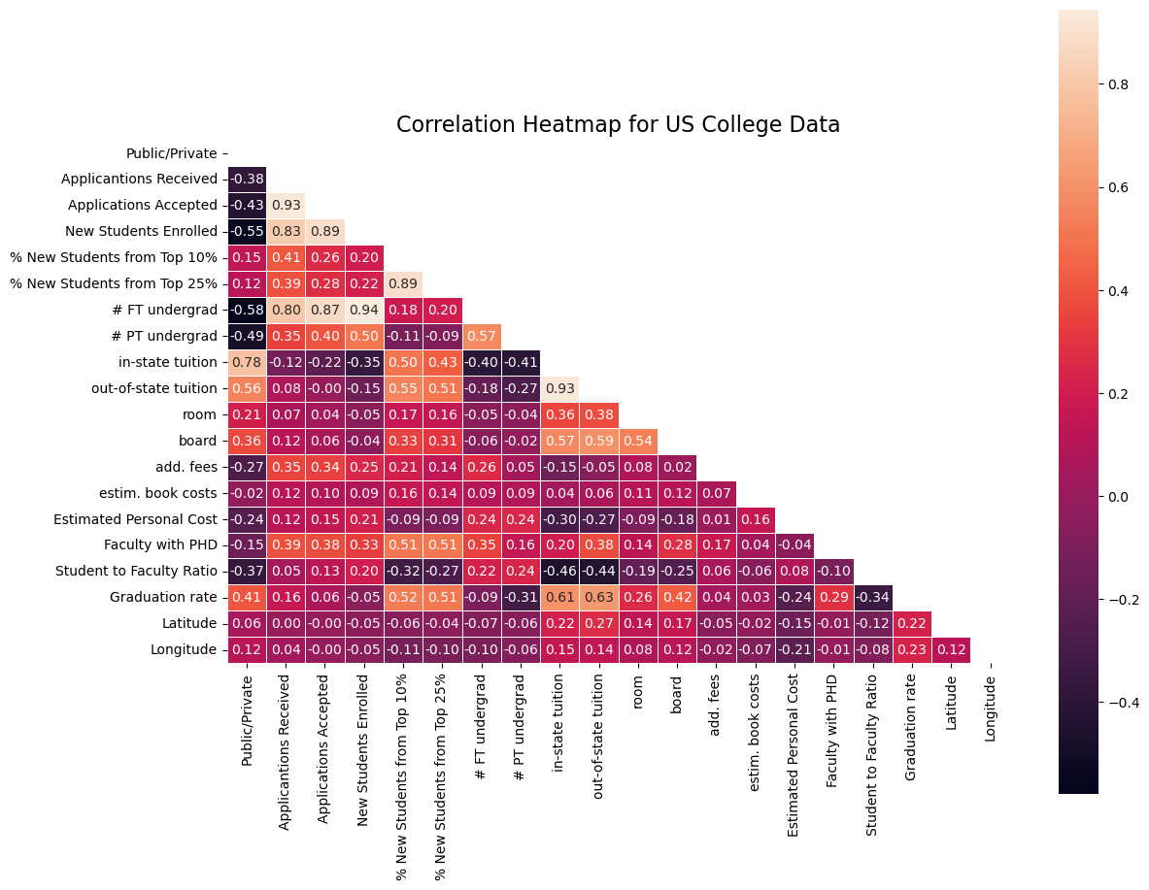
General Correlations
Applications Received, Applications Accepted, and New Students Received are all highly correlated. More enrollment can take more students and get more applications.
Part-time student status moderately negatively relates to Graduation Rates
(Correlation: - 0.31 )
Additional Fees and Estimated Personal costs negatively correlate to Public/Private schools. At the same time, room and board are moderately correlated with public/private, meaning Private schools tend to bundle more components into the room and board, and public schools tend to itemize costs and pass them to students.

Slide 16
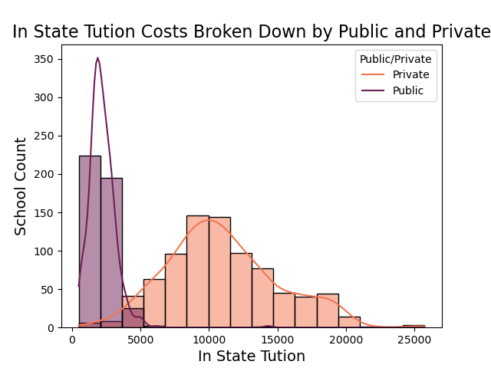
Cost: In-State Tuition
2208
Mean In-State Tuition for Public.
11008
Mean for In-State Tuition for Private Schools (2-tailed ttest p-value = 0.0, Statistic=58.6)
Schools over 20K a year in order of highest to lowest
Middlebury College
Bates College
Franklin and Marshall College Bennington College
Hampshire College
Massachusetts Institute of Technology

Slide 17
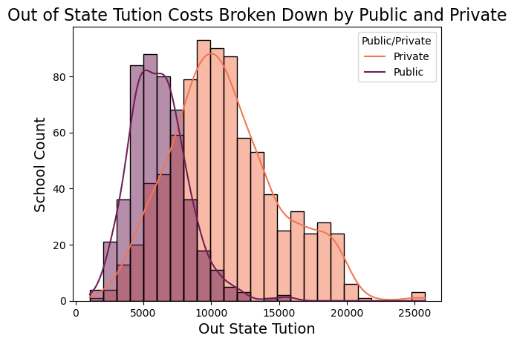
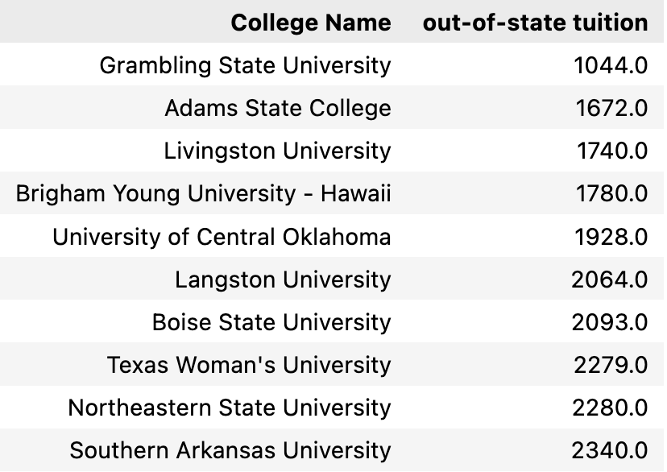
Cost: Out-State Tuition
6152
Mean Out-of-State Tuition for Public.
11008
Mean for Out-of-State Tuition for Private Schools (2-tailed ttest p-value = 0.0, Statistic=58.6)
Lowest Cost for Out-of-State Colleges

Slide 18
Cost: Out-State Tuition
6152
Mean Out-of-State Tuition for Public.
11008
Mean for Out-of-State Tuition for Private Schools (2-tailed ttest p-value = 0.0, Statistic=58.6)
Lowest Cost for Out-of-State Colleges

Slide 19
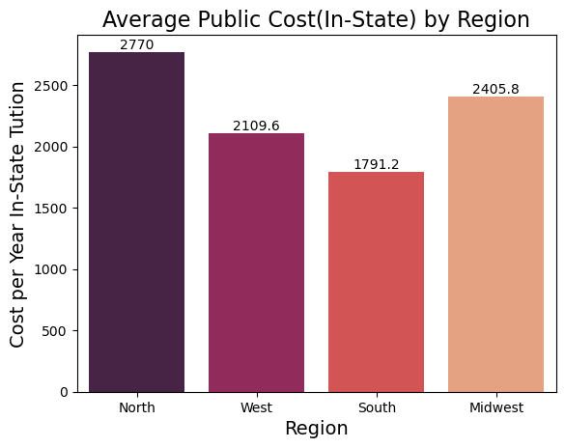
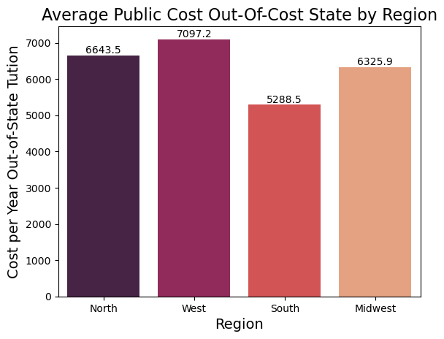

Slide 20
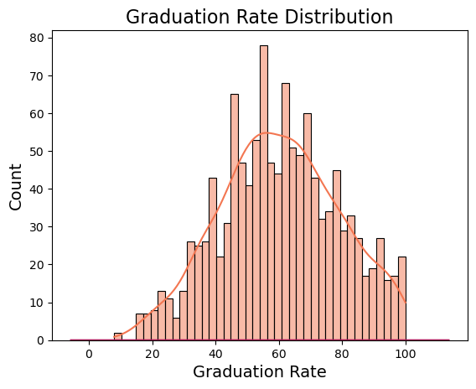
mean 60.343023
std 18.822515
min 8.000000
Max 100
25% 47.000000
50% 60.000000
75% 74.000000
THE BEST AT 100% GRADUATION RATE
Harvey Mudd College
Santa Clara University
Amherst College
Harvard University
Lindenwood College
Missouri Southern State College
Siena College College of Mount St. Joseph Grove City College
University of Richmond Goddard College
Heritage College
THE WORST AT 8% GRADUATION RATE
UNIVERSITY OF HOUSTON DOWNTOWN

Slide 21
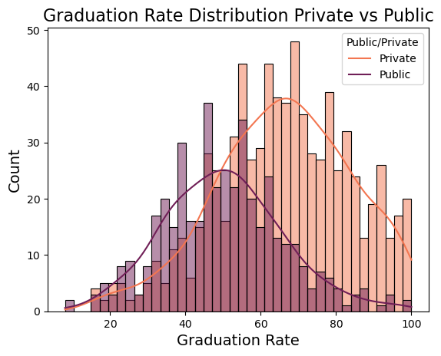
Graduation Rates: Private Schools Do Better
Private Average Graduation Rate
66.07
Public Average Graduation Rate
50.18
2-tailed t-test ( p-value: 0.0, Statistic = 15.03*)
Statistically Significant Difference
We must reject the null hypnosis that private and public school graduation rates are the same.
* p-values are exceedingly small

Slide 22
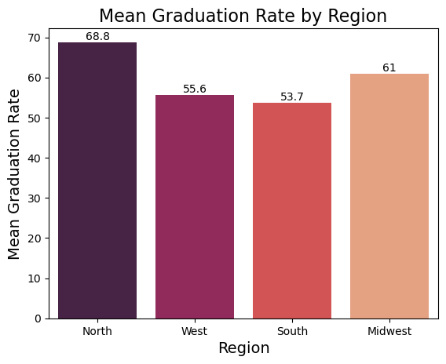
Graduation Rates: Regional Differences Exist
Different US News and World Report Best College Regions 2016 have different graduation rates
( ANOVA p-value= 0.0, fvalue=47.13* )
The North Region does significantly better then even the next highest Midwest Region
( t-test p-value=0.0, statistic=5.8 *)
The West and South Region are not significantly better than each other
( t-test p-value=0.29, statistic=1.05 *)
The Midwest does better than the West and South
( t-test p-value=0.002, statistic=3.02 *)
If you must graduate, attend North Region schools.
* p-values are exceedingly small

Slide 23
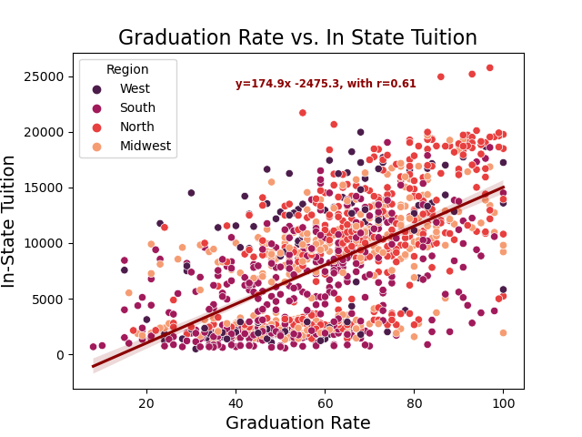
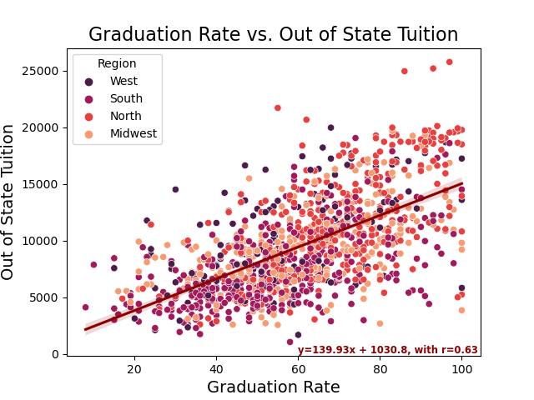
Graduation Rates: Tuition Up, Graduation Rate Up
Spend More to get more? Graduation rates suggest yes.

Slide 24
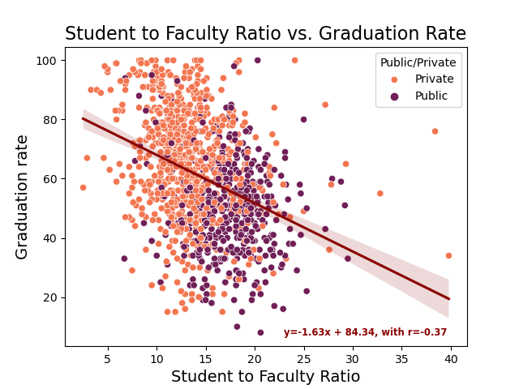
Graduation vs. Faculty to Student Ratio
A lower student-to-faculty ratio does help with higher graduation rates, but it is only moderate.
(Correlation: -0.34)
Most Schools have a ratio of student to faculty ratio between 14-15
(mean: 14.9, median: 14.3 )
Private Schools have statistically significantly smaller Student to Faculty Ratios.
( 2 tailed t-test p-value = 0.0*., Public student to faculty ratio = 17.4, Private student to faculty ratio = 13.1 )

Slide 26
PCA Dimension Reduction The step before machine learning.
Dropped Columns that were too unique
Address1, Address2, Latitude, Longitude,Zip Code,County. Dropping Region as it was not part of the original data.
Hot-Encoding data via pd.get_dummies.
Imputing missing data via Median Strategy.
Imputing missing data via Median Strategy.
Reduction from over 3000 columns hot-econded to just 68
Dropped Region column
Imputing missing data via Median Strategy.
Hot encoding via Pandas module.
Scaling via Standard Scalar

Slide 27
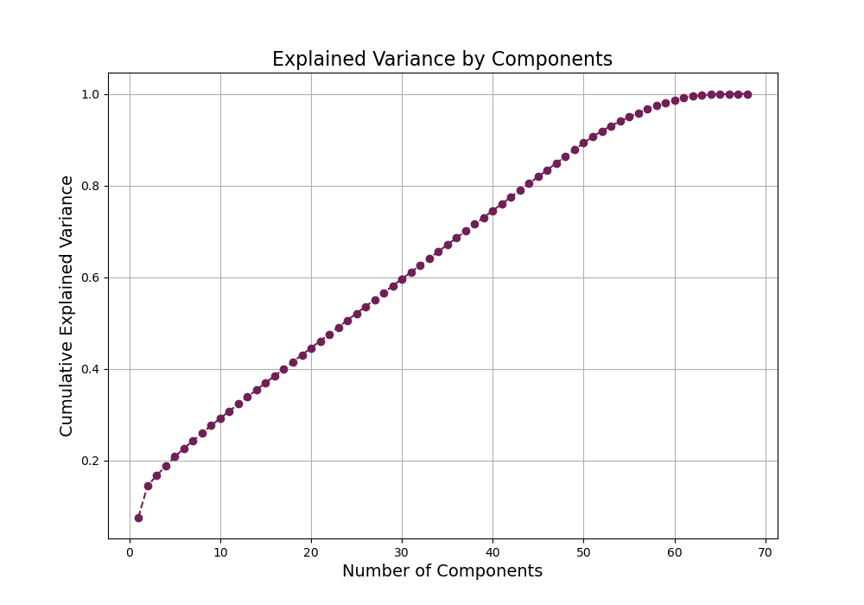
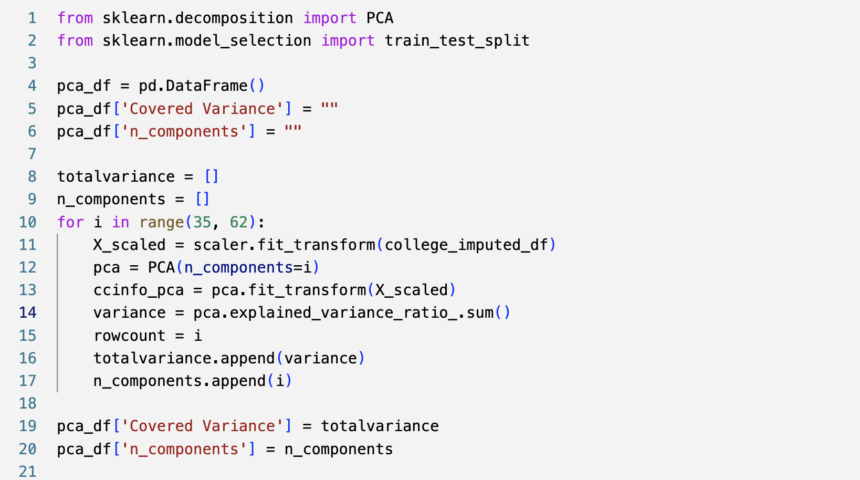
Scree graph stables around 58, checking for the best coverage at the lowest level of n_components.

Slide 28
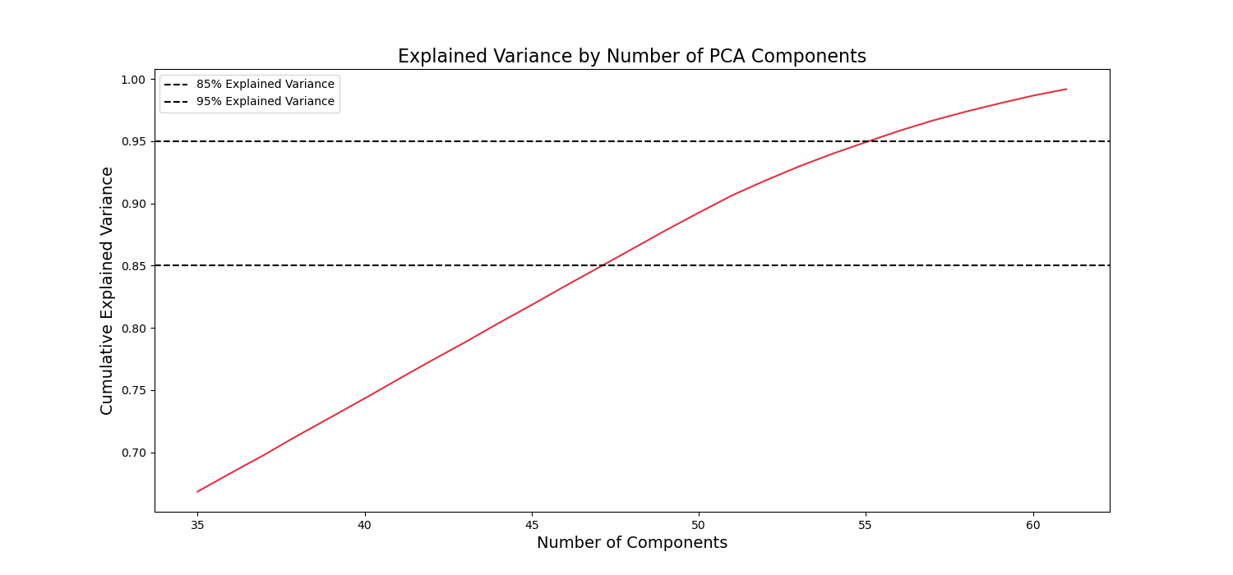

Slide 29
Separate Public and Private fully and analyze each seperately

